Slide 1


Flow Control

Slide 2
Flow Control
The most important responsibilities of the data link layer are flow control and error control
Collectively, these functions are known as data link control
It is one of the most important functions of data link layer

Slide 3
Flow Control
Flow control refers to a set of procedures used to restrict the amount of data that the sender can send before waiting for acknowledgment
Flow control coordinates the amount of data that can be sent before receiving
acknowledgement
Flow control is a set of procedures that tells the sender how much data it can transmit before it must wait for an acknowledgement from the receiver

Slide 4
Flow Control
Receiver has a limited speed at which it can process incoming data and a limited amount of memory in which to store incoming data
Receiver must inform the sender before the limits are reached and request that
the transmitter to send fewer frames or stop temporarily
Since the rate of processing is often slower than the rate of transmission, receiver has a block of memory (buffer) for storing incoming data until they are processed

Slide 5
Flow Control
Two Approaches:
  Feedback based flow control
    The receiver sends back information
to the sender giving it permission to send more data or at
least telling the sender how the receiver is doing
Rate based flow control
  The protocol has a built in mechanism that limits the rate at which senders may transmit data, without using feedback from the receiver
Various flow control schemes uses a common protocol that contains well- defined rules about when a sender may transmit the next frame
These rules often prohibit frames from being sent until the receiver has granted permission, either implicitly or explicitly

Slide 6
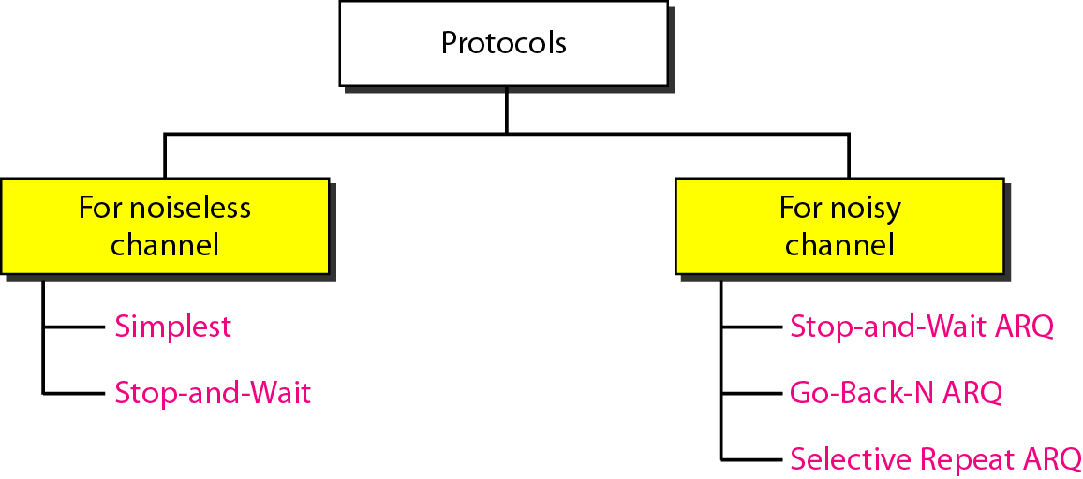
Flow Control

Slide 7
Noiseless channel
Let us first assume we have an ideal channel in which no frames are lost, duplicated, or corrupted
Two protocols for this type of channel
  Simplest Protocol
  Stop-and-Wait Protocol

Slide 8
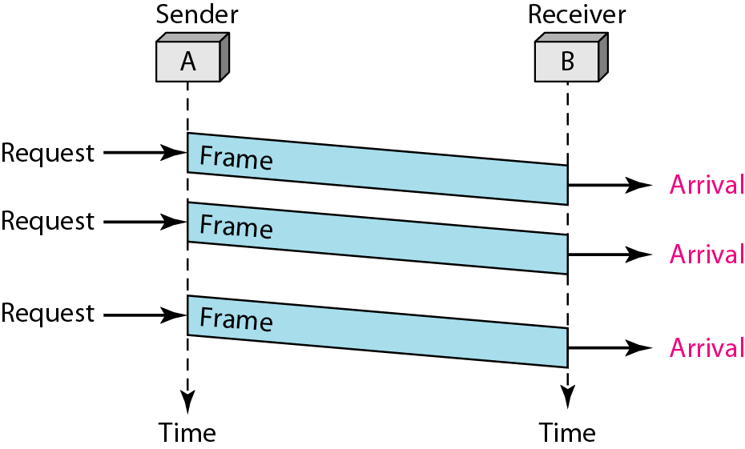
Simplest Protocol

Slide 9
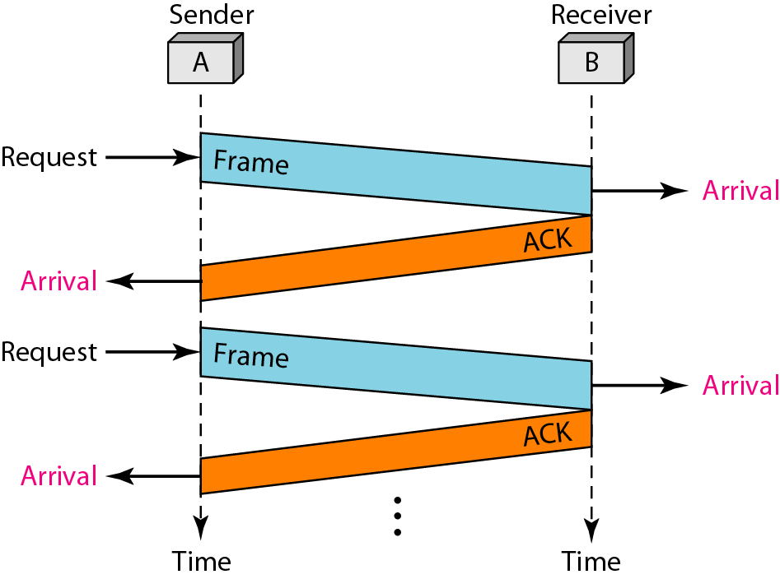
Stop and Wait Protocol

Slide 10
Noisy channel
Three protocols
  Stop-and-Wait Automatic Repeat Request
  Go-Back-N Automatic Repeat Request
  Selective Repeat Automatic Repeat Request
NOTE:
Round Trip Time (RTT)
  Time taken by frame to travel from sender to receiver + Time taken by corresponding frame ACK to travel from receiver to sender
Thus,
  RTT = 2* Tp (Twice Propagation Time)

Slide 11
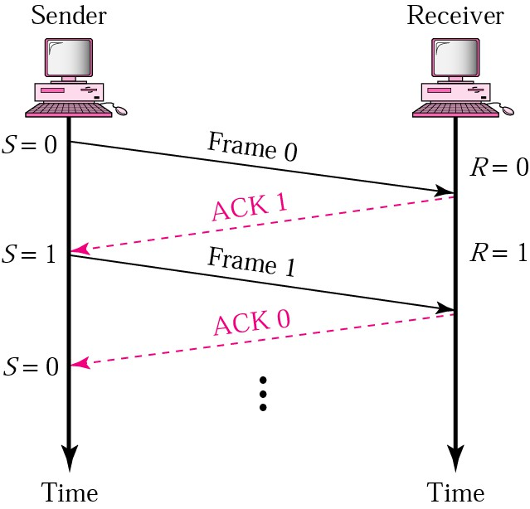
Stop and Wait ARQ (General Scenario)
Sender keeps a copy of the last frame until it receives an acknowledgement
For identification, data frame and acknowledgement (ACK) frames are numbered alternatively 0 and 1
Sender has a control variable “S” that holds the number of the recently sent frame. (0 or 1)
Receiver has a control variable “R” that holds the number of the next frame expected (0 or 1)
Sender starts a timer when it sends a frame. If an ACK is not received within a allocated time period, the sender assumes that the frame was lost or damaged and resends it
Receiver send only positive ACK if the frame is received
ACK number always defines the number of the next
expected frame

Slide 12
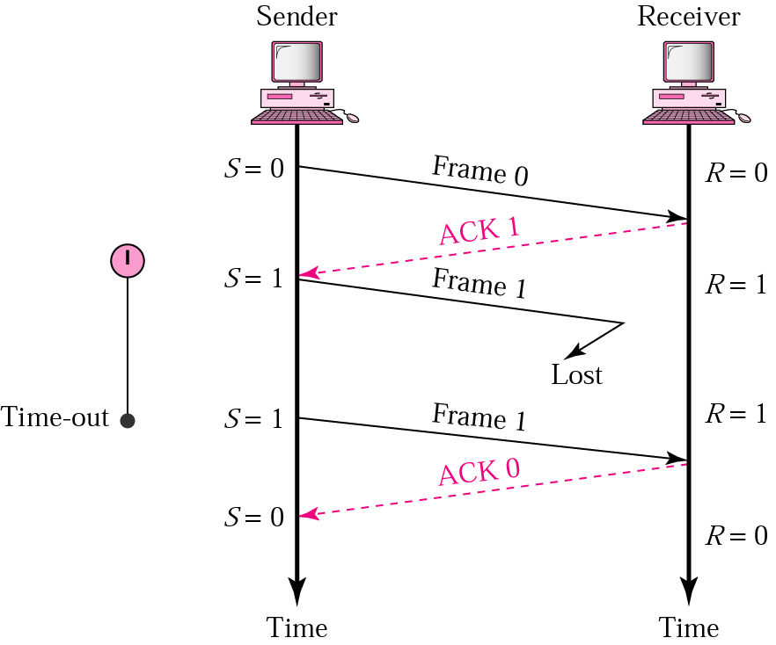
Stop and Wait ARQ (Damaged frame)
When a receiver receives a damaged frame, it discards it and keeps its value of R
After the timer at the sender expires, another copy of frame 1 is sent

Slide 13
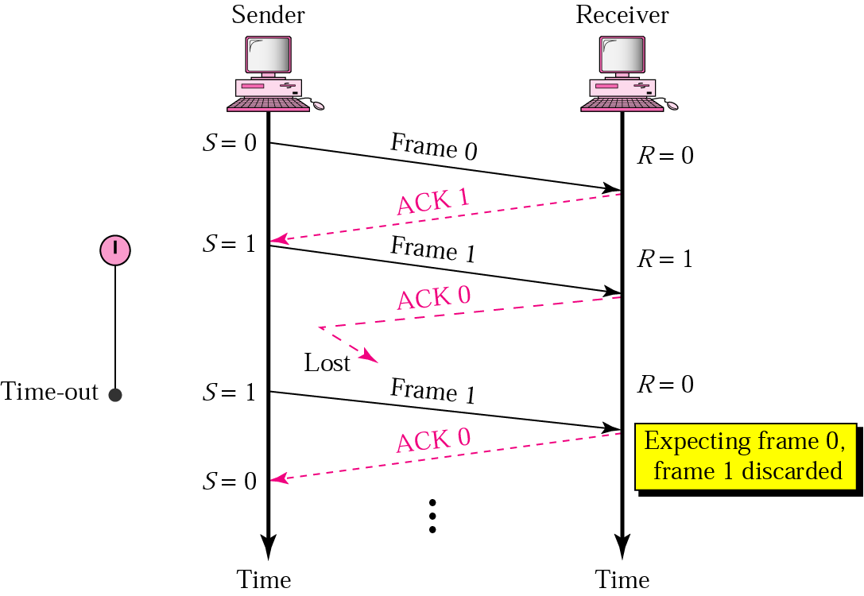
Stop and Wait ARQ (Damaged ACK)
If the sender receives a damaged ACK, it discards it
When the timer of the sender expires, the sender retransmits frame 1
Receiver has already received
frame 1 receive Therefore
and expecting to
frame 0 (R=0). it discards the
second copy of frame 1

Slide 14
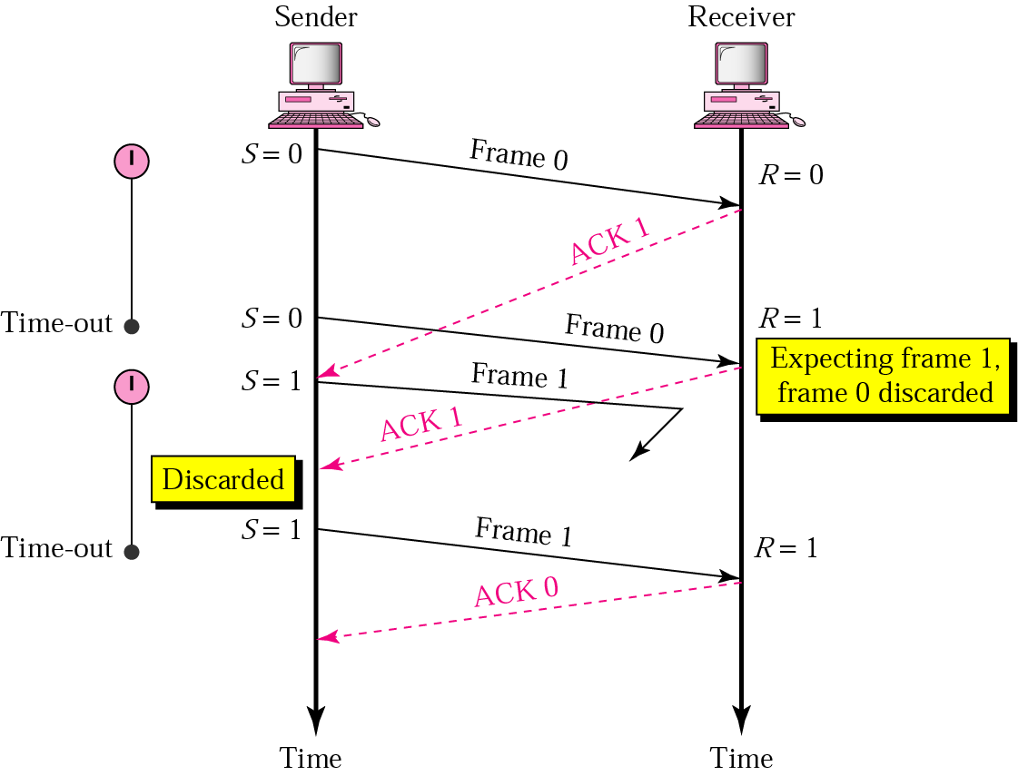
Stop and Wait ARQ (ACK delayed)
The ACK can be delayed at the receiver or due to some problem
It is received after the timer for
frame 0 has expired
Sender retransmitted a copy of frame 0. However, R =1 means receiver expects to see frame 1. Receiver discards the duplicate frame 0
Sender receives 2 ACKs, it
discards the second ACK

Slide 15
Stop and Wait ARQ
Error correction in Stop-and-Wait ARQ is done by keeping a copy of the sent frame and retransmitting of the frame when the timer expires
In Stop-and-Wait ARQ, we use sequence numbers to number the frames
The sequence numbers are based on modulo-2 arithmetic
In Stop-and-Wait ARQ, the acknowledgment number always announces in modulo-2 arithmetic the sequence number of the next frame expected

Slide 16
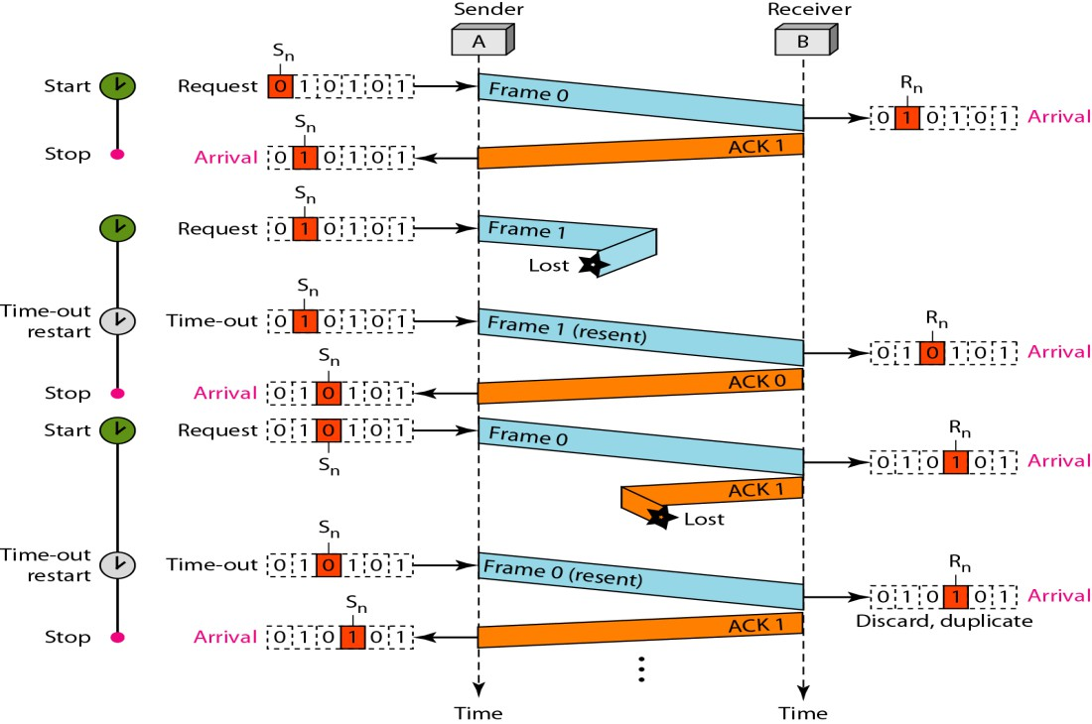
Stop and Wait ARQ
Eg:
  As seen from the figure, Frame 0 is sent and acknowledged
  Frame 1 is lost and resent after the
time-out
  The resent frame 1 is acknowledged and the timer stops
  Frame 0 is sent and acknowledged,
but the acknowledgment is lost
  The sender has no idea if the frame or the acknowledgment is lost, so after the time-out it resends frame 0, which is acknowledged

Slide 17
Stop and Wait ARQ
Eg:
– Assume that, in a Stop-and-Wait ARQ system, the bandwidth of the line is 1 Mbps, and 1 bit takes 20 ms to make a round trip. What is the bandwidth- delay product?
Solution
The bandwidth-delay product is

Slide 18
Stop and Wait ARQ
Eg: (contd)
– If the system data frames are 1000 bits in length, what is the utilization percentage of the link?
Solution
The system can send 20,000 bits during the time it takes for the data to go from the sender to the receiver and then back again
However, the system sends only 1000 bits
We can say that the link utilization is only 1000/20,000, or 5 percent
For this reason, a link with a high bandwidth or long delay, the use of Stop-and-
Wait ARQ wastes the capacity of the link

Slide 19
Stop and Wait ARQ
Eg: (contd)
– What is the utilization percentage of the link if we have a protocol that can send up to 15 frames before stopping and worrying about the acknowledgments?
Solution
The bandwidth-delay product is still 20,000 bits
The system can send up to 15 frames or 15,000 bits during a round trip
This means the utilization is 15,000/20,000, or 75 percent
If there are damaged frames, the utilization percentage is much less
because frames have to be resent

Slide 20
Stop and Wait ARQ
Disadvantages
  At any point in time, there is only one frame that is sent and waiting to be acknowledged
  This is not a good use of transmission medium
  Efficiency is very low
  To improve efficiency, multiple frames should be in transition while waiting for ACK
Two protocol use the above concept
Go back N ARQ
Selective repeat ARQ

Slide 21
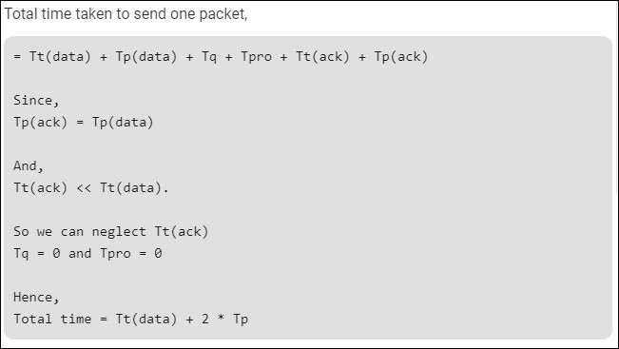
Stop and Wait ARQ

Slide 22
Stop and Wait ARQ
Efficiency (η) = Useful time / Total cycle time
= Tt / (Tt + 2*Tp)
= 1 / (1+2*(Tp/Tt))
= 1 / (1+2*a)
where, a = Tp / Tt
Throughput
– Number of bits send per second, which is also known as Effective Bandwidth or
Bandwidth utilization
Throughput = η * BW
where, BW is Bandwidth

Slide 23
Stop and Wait ARQ
Eg:
– If the bandwidth of the line is 1.5 Mbps, RTT is 45 msec and packet size is 1 KB, then find the link utilization in stop and wait
Solution
Transmission delay (T_{t}) = Packet size / Bandwidth
= 1 KB / 1.5 Mbps
= (2¹⁰ x 8 bits) / (1.5 x 10⁶ bits/sec)
= 5.461 msec

Slide 24
Stop and Wait ARQ
Propagation delay (Tp) = Round Trip Time / 2
= 45 msec/2
= 22.5 msec
Calculating Value Of „a‟
a = Tp / Tt
a = 22.5/5.461
a = 4.12 msec
Link Utilization or Efficiency (η) = 1 / 1+2a
= 1 / (1 + 2 x 4.12)
= 1 / 9.24
= 0.108
= 10.8 %

Slide 25
Stop and Wait ARQ
Eg:
  A channel has a bit rate of 4 Kbps and one way propagation delay of 20 msec. The channel uses stop and wait protocol. The transmission time of the acknowledgement frame is negligible. To get a channel efficiency of at least 50%, the minimum frame size should be
  80 bytes
  80 bits
  160 bytes
  160 bits
Solution
Bandwidth = 4 Kbps, Propagation delay (Tp) = 20 msec, Efficiency >= 50%
Let the required frame size = L bits
Transmission delay (Tt) = Packet size / Bandwidth
= L bits / 4 Kbps
79

Slide 26
Stop and Wait ARQ
Condition for efficiency to be at least 50 %
For efficiency to be at least 50%, we must have
1 / 1+2a >= 1/2
a <= 1/2
Substituting the value of „a‟, we get
(20 msec x 4 Kbps) / L bits <= 1/2
L bits >= (20 msec x 4 Kbps) x 2
L bits >= (20 x 10-3 sec x 4 x 103 bits per sec) x 2
L bits >= 20 x 4 bits x 2
L >= 160
From here, frame size must be at least 160 bits

Slide 27
Disadvantage of Stop and Wait
In stop-and-wait, at any point in time, there is only one frame that is sent and waiting to be acknowledged
This is not a good use of transmission medium
To improve efficiency, multiple frames should be in transition while waiting for
ACK
Two protocol use the above concept,
  Go-Back-N ARQ
  Selective Repeat ARQ

Slide 28
Go Back N ARQ
We can send up to W frames before worrying about ACKs
We keep a copy of these frames until the ACKs arrive
This procedure requires additional features to be added to Stop and Wait ARQ

Slide 29
Sequence Numbers
Frames from a sender are numbered sequentially
We need to set a limit since we need to include the sequence number of each frame in the header
If the header of the frame allows m bits for sequence number, the sequence
numbers range from 0 to 2 ^{m} – 1
For m = 3, sequence numbers are: 1, 2, 3, 4, 5, 6, 7
We can repeat the sequence number
Sequence numbers are 0, 1, 2, 3, 4, 5, 6, 7, 0, 1, 2, 3, 4, 5, 6, 7, 0, 1, …

Slide 30
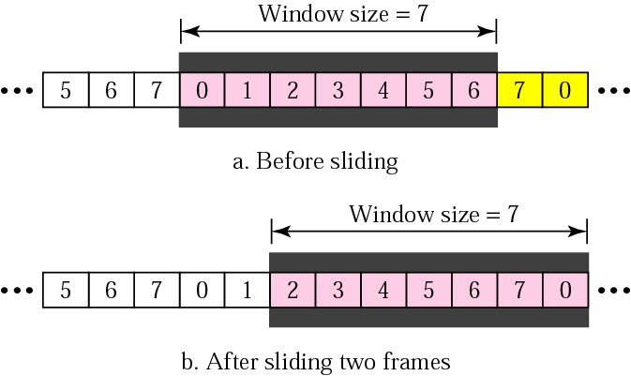
Sender Sliding Window
At the sending site, to hold the outstanding frames until they are acknowledged, we use the concept of a window
The size of the window is at most 2^{m} -1, where m is the number of bits for the sequence number
Size of the window can be
variable, e.g. TCP
The window slides to include new unsent frames when the correct ACKs are received

Slide 31
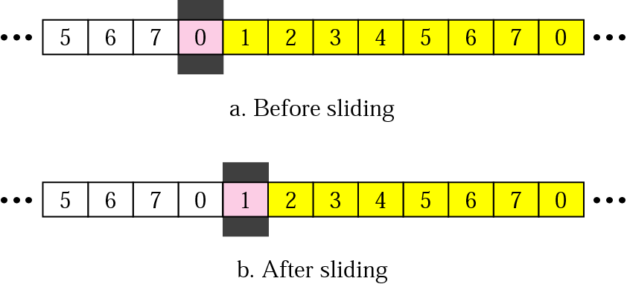
Receiver Sliding Window
Size of the window at the receiving site is always 1 in this protocol
Receiver is always looking for a specific frame to arrive in a specific order
Any frame arriving out of order is discarded and needs to be resent.
Receiver window slides as shown in fig. Receiver is waiting for frame 0 in part a

Slide 32
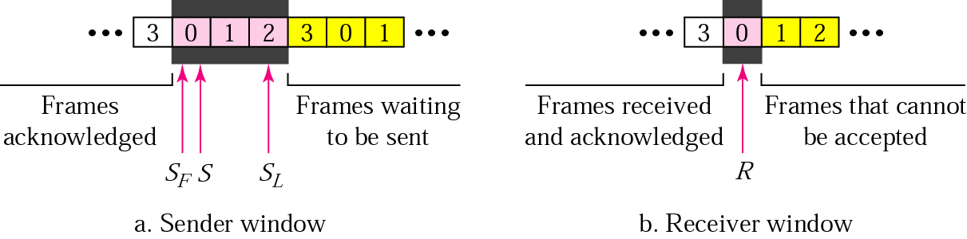
Control Variables
Sender has 3 variables: S, SF, and SL
S holds the sequence number of recently sent frame
SF holds the sequence number of the first frame
SL holds the sequence number of the last frame
Receiver only has the one variable, R, that holds the sequence number of the frame it expects to receive. If the seq. no. is the same as the value of R, the frame is accepted, otherwise rejected

Slide 33
Acknowledgement
Receiver sends positive ACK if a frame arrived safe and in order
If the frames are damaged/out of order, receiver is silent and discard all subsequent frames until it receives the one it is expecting
The silence of the receiver causes the timer of the unacknowledged frame to expire
Then the sender resends all frames, beginning with the one with the expired timer
For example, suppose the sender has sent frame 6, but the timer for frame 3 expires (i.e. frame 3 has not been acknowledged), then the sender goes back and sends frames 3, 4, 5, 6 again. Thus it is called Go-Back-N-ARQ
The receiver does not have to acknowledge each frame received, it can send one cumulative ACK for several frames

Slide 34
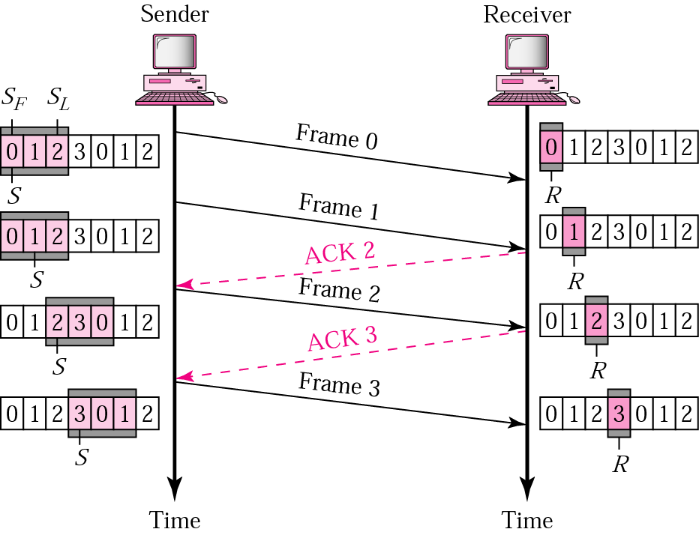
Go Back N ARQ, normal operation
The sender keeps track of the outstanding frames and updates the variables and windows as the ACKs arrive

Slide 35
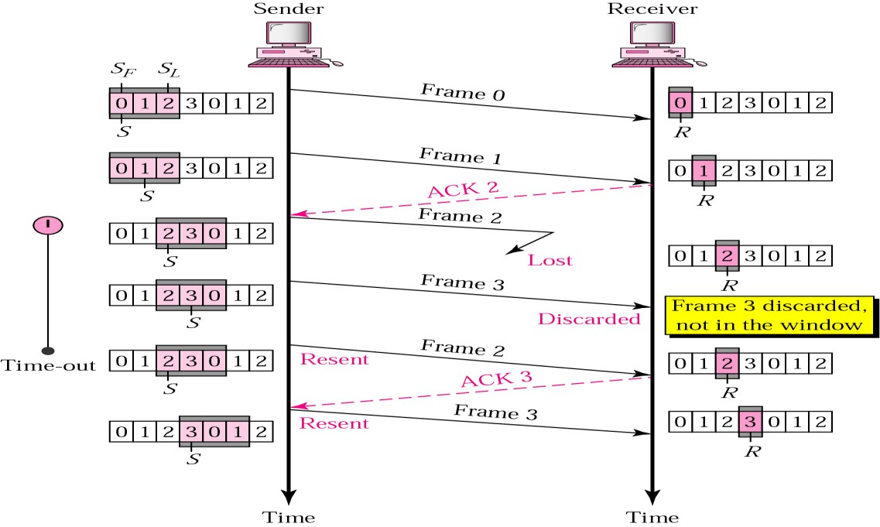
Go Back N ARQ, lost frame
Frame 2 is lost
When the receiver receives frame 3, it discards frame 3 as it is expecting frame 2 (according to window)
After the timer for frame 2 expires at the sender site, the sender sends frame 2 and 3. (go back to 2)

Slide 36
Go Back N ARQ, damaged/lost/delayed ACK
If an ACK is damaged/lost, we can have two situations
If the next ACK arrives before the expiration of any timer, there is no need for retransmission of frames because ACKs are cumulative in this protocol
If ACK1, ACK2, and ACk3 are lost, ACK4 covers them if it arrives before the
timer expires
If ACK4 arrives after time-out, the last frame and all the frames after that are
resent
Receiver never resends an ACK
A delayed ACK also triggers the resending of frames

Slide 37
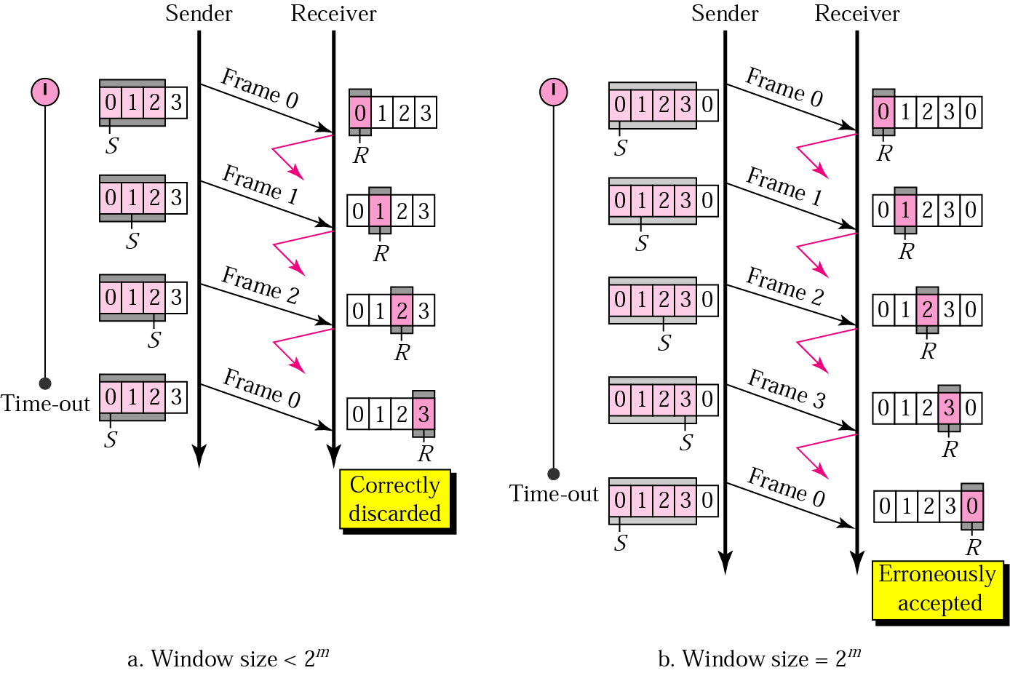
Go Back N ARQ, sender window size
Size of the sender window must be less than 2^{m}
Size of the receiver is always 1

Slide 38
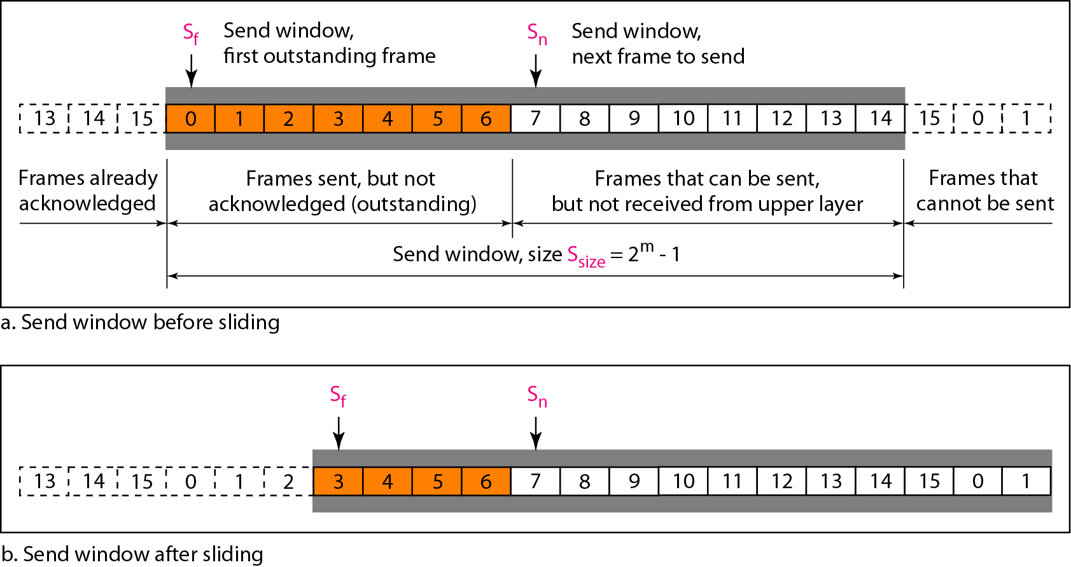
Go Back N ARQ (sending window)

Slide 39
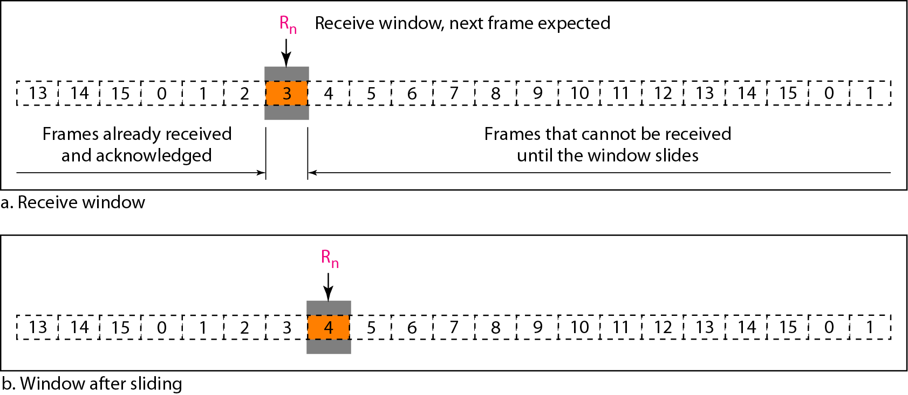
Go Back N ARQ (receiving window)

Slide 40
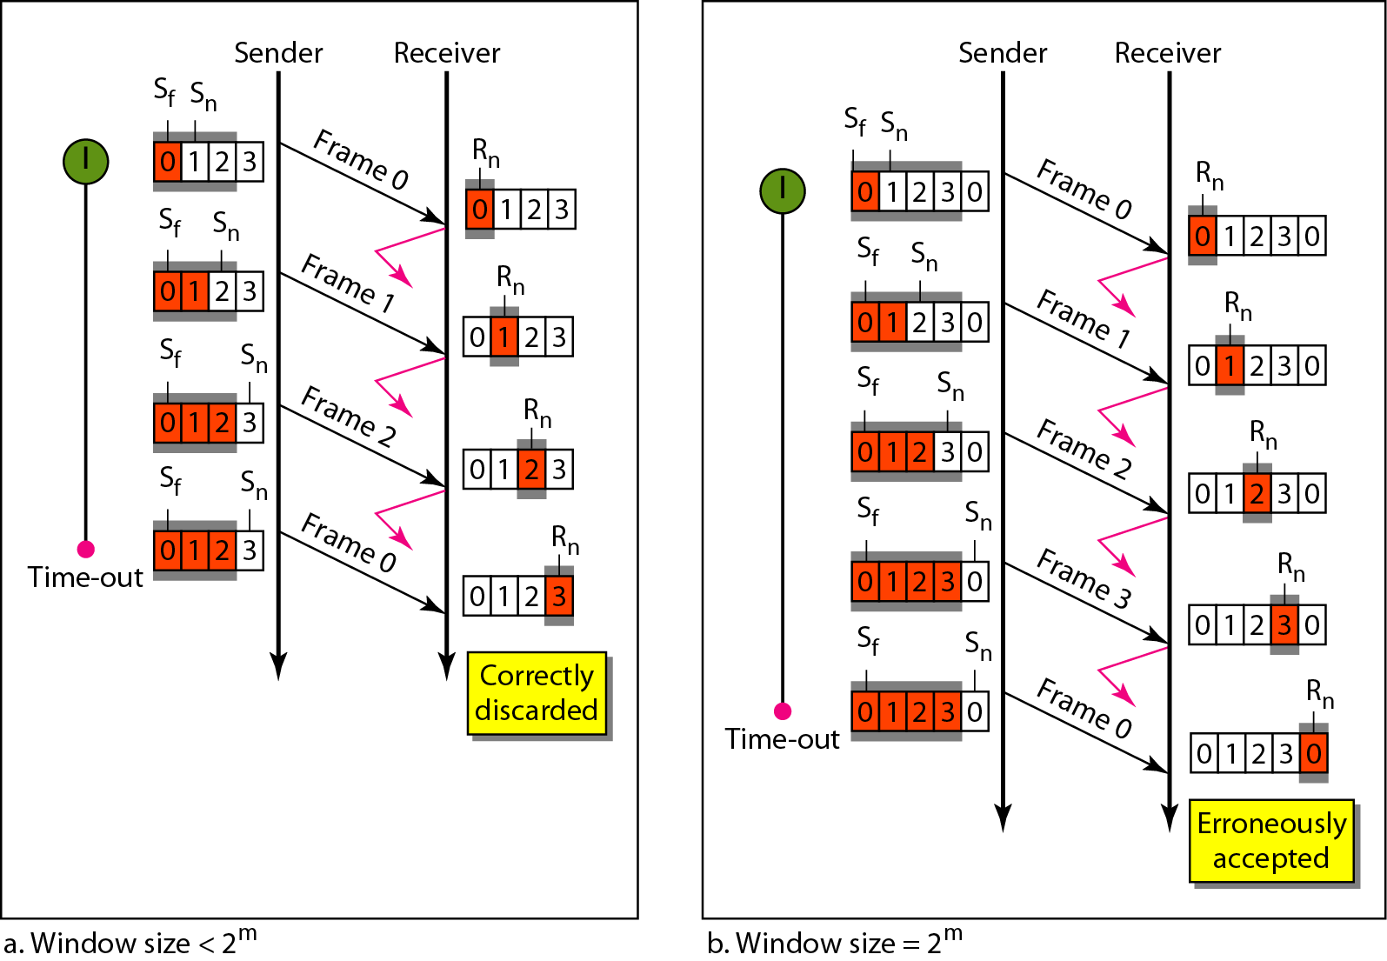
Go Back N ARQ (sending and receiving window)

Slide 41
Go Back N ARQ
Eg:
– Figure shows an example of Go Back N. This is an example of a case where the forward channel is reliable, but the reverse is not. No data frames are lost, but some ACKs are delayed and one is lost. The example also shows how cumulative acknowledgments can help if acknowledgments are delayed or lost. After initialization, there are seven sender events. Request events are triggered by data from the network layer; arrival events are triggered by acknowledgments from the physical layer. There is no time-out event here because all outstanding frames are acknowledged before the timer expires. Note that although ACK 2 is lost, ACK 3 serves as both ACK 2 and ACK 3.

Slide 42
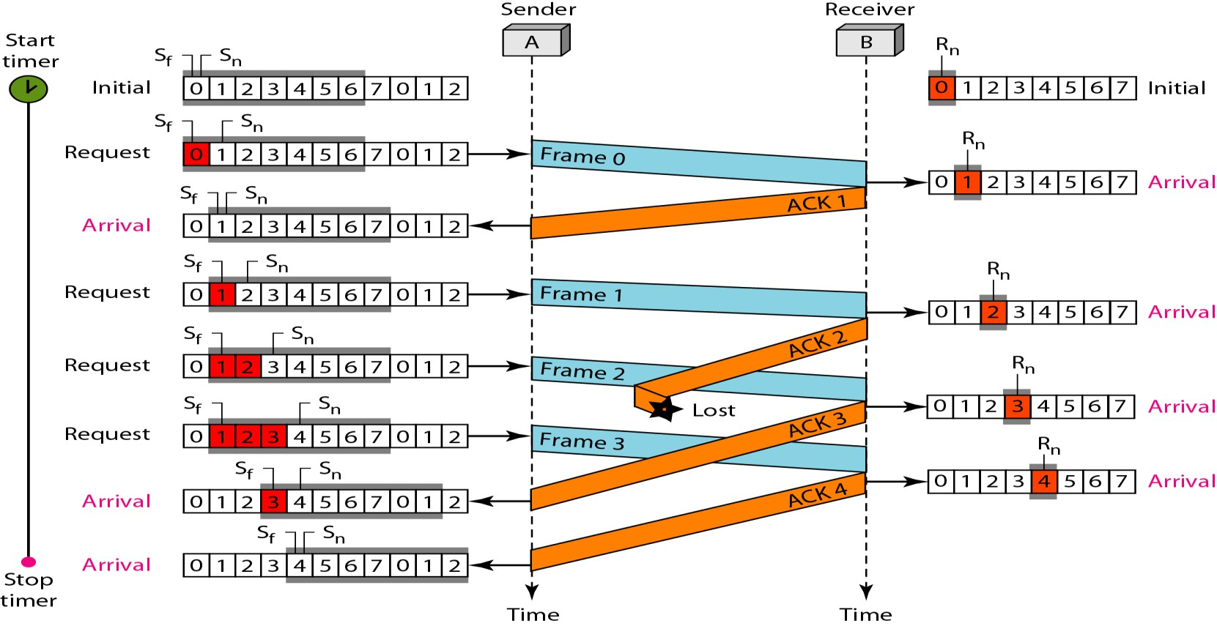
Go Back N ARQ

Slide 43
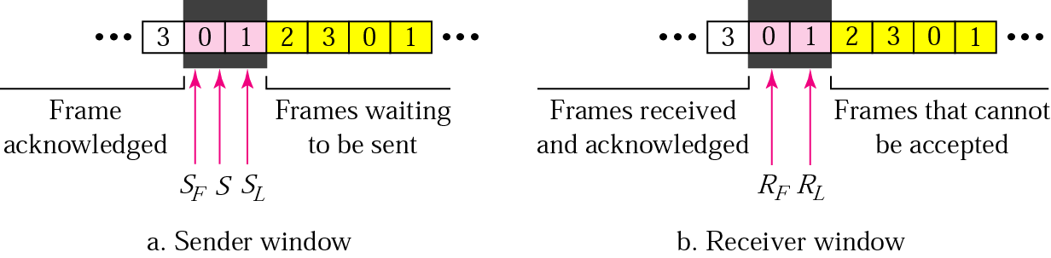
Selective Repeat ARQ, sender and receiver windows
Go Back N ARQ simplifies the process at the receiver site. Receiver only keeps track of only one variable, and there is no need to buffer out-of-order frames, they are simply discarded. However, Go Back N ARQ protocol is inefficient for noisy link
In Selective Repeat ARQ, only the damaged frame is resent. More bandwidth efficient but more complex processing at receiver
It defines a negative ACK (NAK) to report the sequence number of a damaged frame before the timer expires

Slide 44
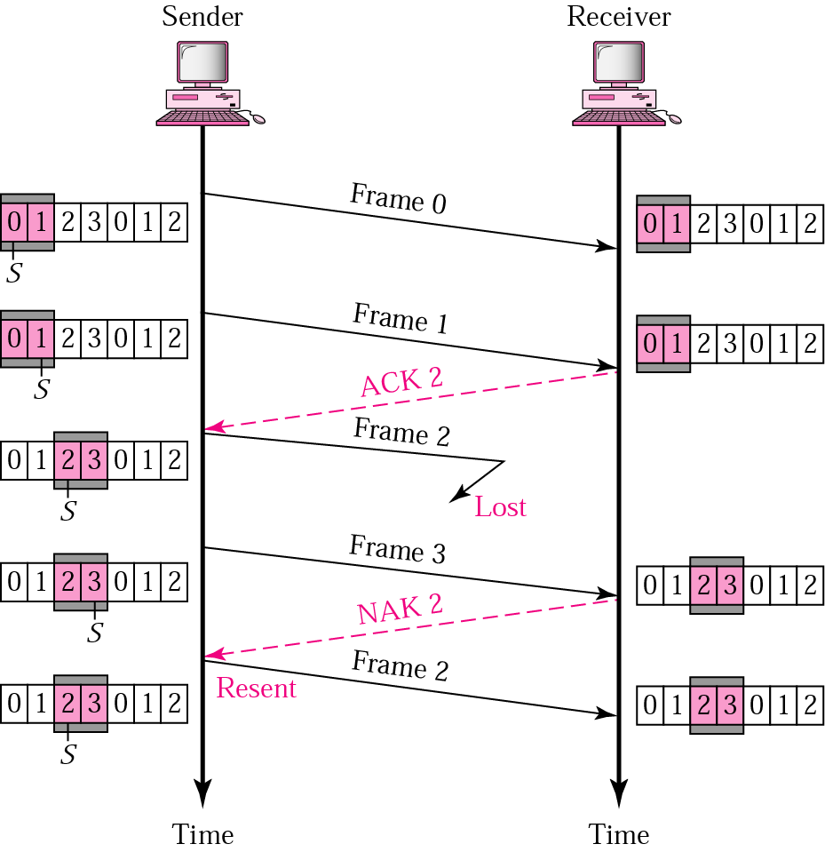
Selective Repeat ARQ, lost frame
Frames 0 and 1 are accepted when received because they are in the range specified by the receiver window. Same for frame 3
Receiver sends a NAK2 to show that frame 2 has not been received and then sender resends only frame 2 and it is accepted as it is in the range of the window

Slide 45
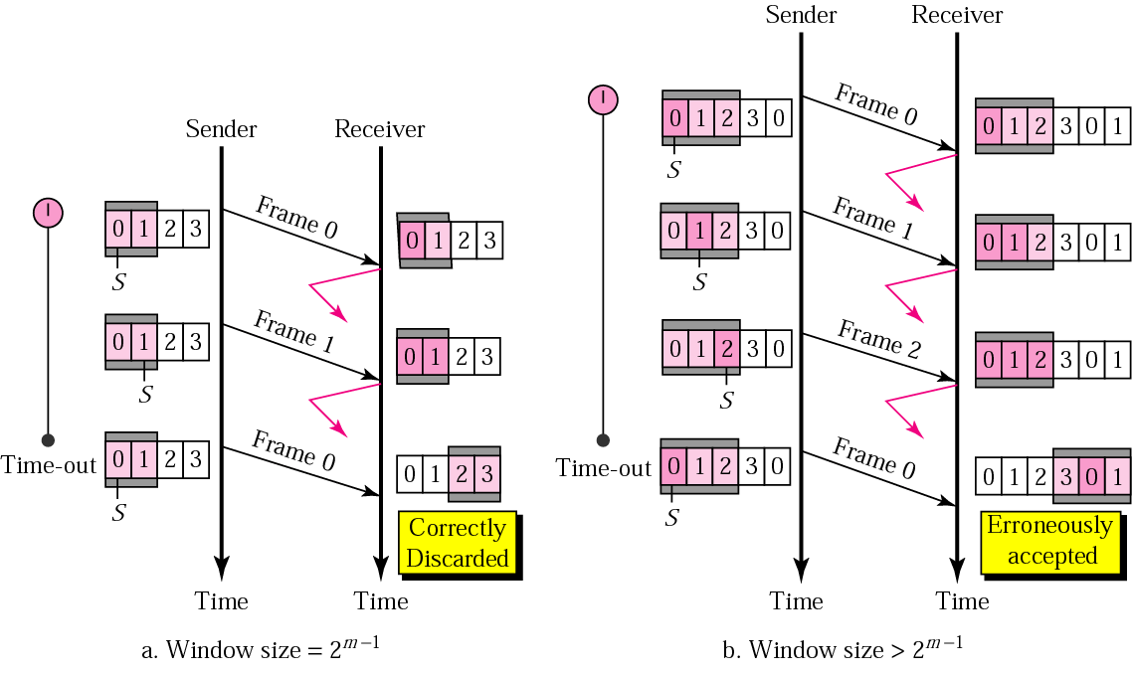
Selective Repeat ARQ, sender window size
Size of the sender and receiver windows must be at most one-half of 2^{m}. If m = 2, window size should be 2^{m}/2 = 2
Fig compares a window size of 2 with a window size of 3. Window size is 3 and all ACKs are lost, sender sends duplicate of frame 0, window of the receiver expect to receive frame 0, so accepts frame 0, as the 1st frame of the next cycle – an error

Slide 46
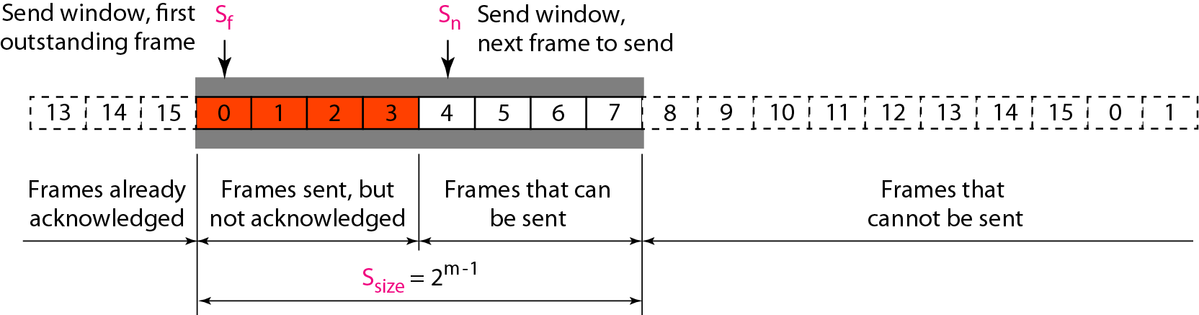
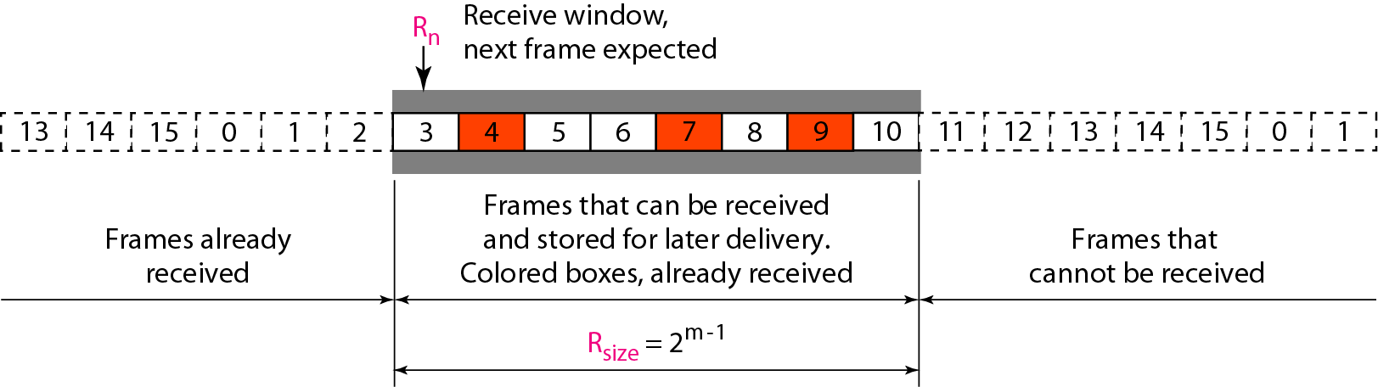
Window for Selective Repeat ARQ

Slide 47
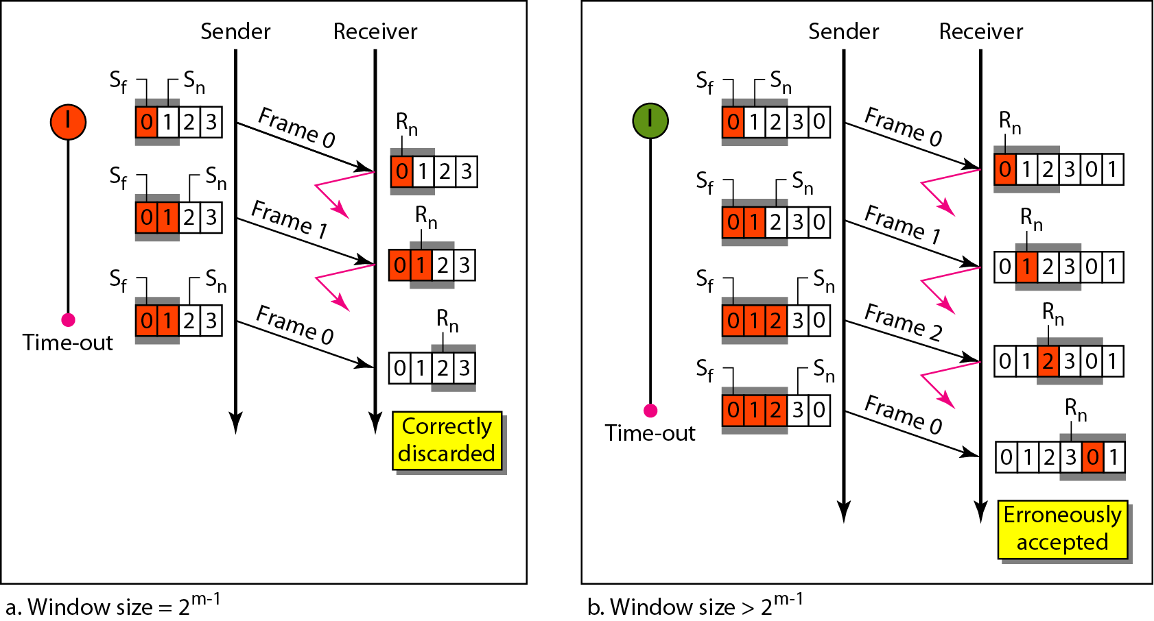
Window for Selective Repeat ARQ

Slide 48
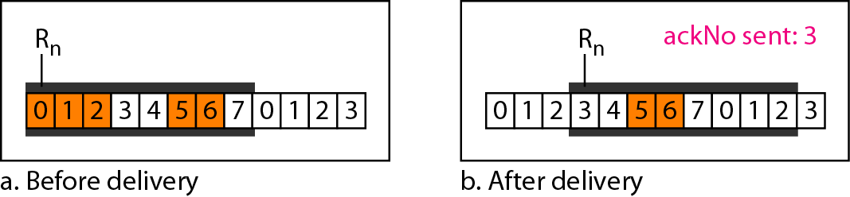
Delivery of data in Selective Repeat ARQ

Slide 49
Selective Repeat ARQ
Eg:
  This example is similar to previous example in which frame 1 is lost. We show how Selective Repeat behaves in this case. Figure 11.23 shows the situation. One main difference is the number of timers. Here, each frame sent or resent needs a timer, which means that the timers need to be numbered (0, 1, 2, and 3). The timer for frame 0 starts at the first request, but stops when the ACK for this frame arrives. The timer for frame 1 starts at the second request, restarts when a NAK arrives, and finally stops when the last ACK arrives. The other two timers start when the corresponding frames are sent and stop at the last arrival event.
  At the receiver site we need to distinguish between the acceptance of a frame and its delivery to the network layer. At the second arrival, frame 2 arrives and is stored and marked, but it cannot be delivered because frame 1 is missing. At the next arrival, frame 3 arrives and is marked and stored, but still none of the frames can be delivered. Only at the last arrival, when finally a copy of frame 1 arrives, can frames 1, 2, and 3 be delivered to the network layer. There are two conditions for the delivery of frames to the network layer: First, a set of consecutive frames must have arrived. Second, the set starts from the beginning of the window.

Slide 50
Selective Repeat ARQ
Eg: (contd…)
  Another important point is that a NAK is sent after the second arrival, but not after the third, although both situations look the same. The reason is that the protocol does not want to crowd the network with unnecessary NAKs and unnecessary resent frames. The second NAK would still be NAK1 to inform the sender to resend frame 1 again; this has already been done. The first NAK sent is remembered (using the nakSent variable) and is not sent again until the frame slides. A NAK is sent once for each window position and defines the first slot in the window.
  The next point is about the ACKs. Notice that only two ACKs are sent here. The first one acknowledges only the first frame; the second one acknowledges three frames. In Selective Repeat, ACKs are sent when data are delivered to the network layer. If the data belonging to n frames are delivered in one shot, only one ACK is sent for all of them.

Slide 51
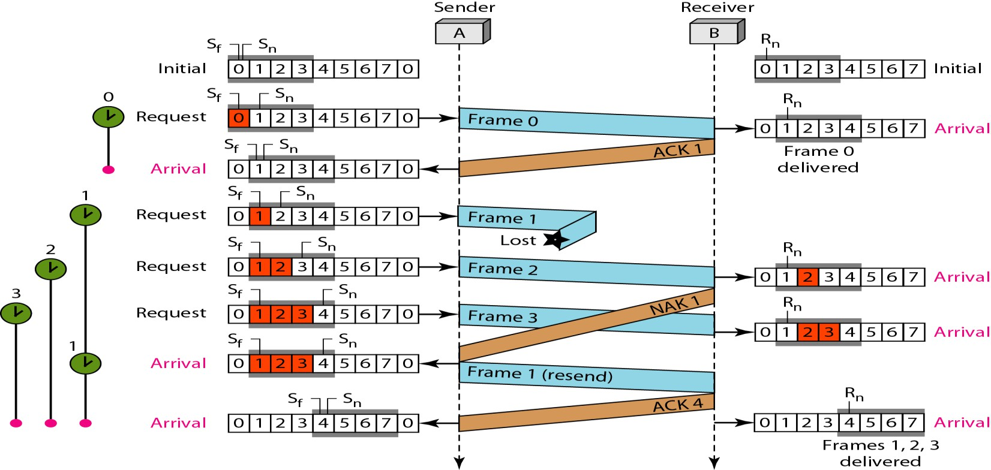
Selective Repeat ARQ

